Slide 1
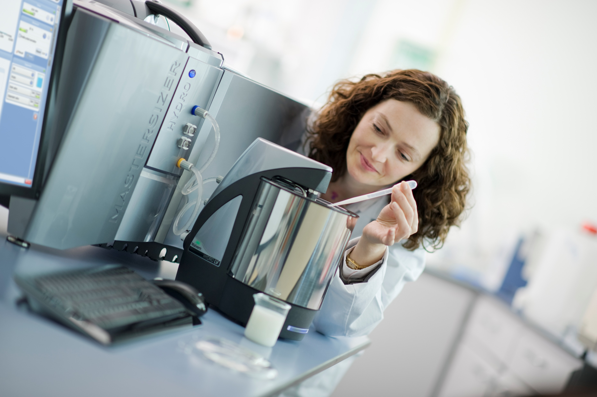
Examples transferring methods from the Mastersizer 2000 to the Mastersizer 30000
Dr Stephen Ward-Smith MRSC

Slide 2
First need to briefly recap the methodology of transfer from last months webinar.
Go through several examples of transfer

Slide 3
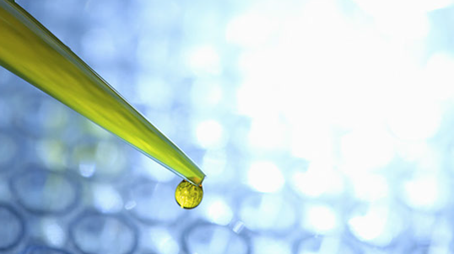
Using risk assessment tools for method transfer

Slide 4
Risk assessment
For liquid dispersion methods
Instrument Model
Dispersion state:
Sonication power/time
Pump stir speed
Analysis Range
Pre-dispersion method
Analyst
Instrument
Measurement
Cleanliness
Measurement time
Sampling Method
Laser Obscuration
Weighing Method
Analysis settings
Laser Alignment
Sample Source / Lot
Optical Properties
Humidly
Sample transfer to Instrument
Verification Materials
Material
Method
Temperature
Environment
Dispersant Source
Sample quantity
Sample preparation
Dispersant Grade
Reference method

Slide 5
Risk assessment
For dry dispersion methods
Analysis settings
Instrument Model
Dispersion Pressure
Analysis Range
Feed Rate
Analyst
Cleanliness
Instrument
Measurement time
Measurement
Weighing Method
Extraction
Laser Obscuration
Air Supply
Laser Alignment
Sample Source / Lot
Optical Properties
Humidly
Verification Materials
Sample transfer to Instrument
Material
Method
Temperature
Environment
Air quality
Sample quantity
Reference method

Slide 6
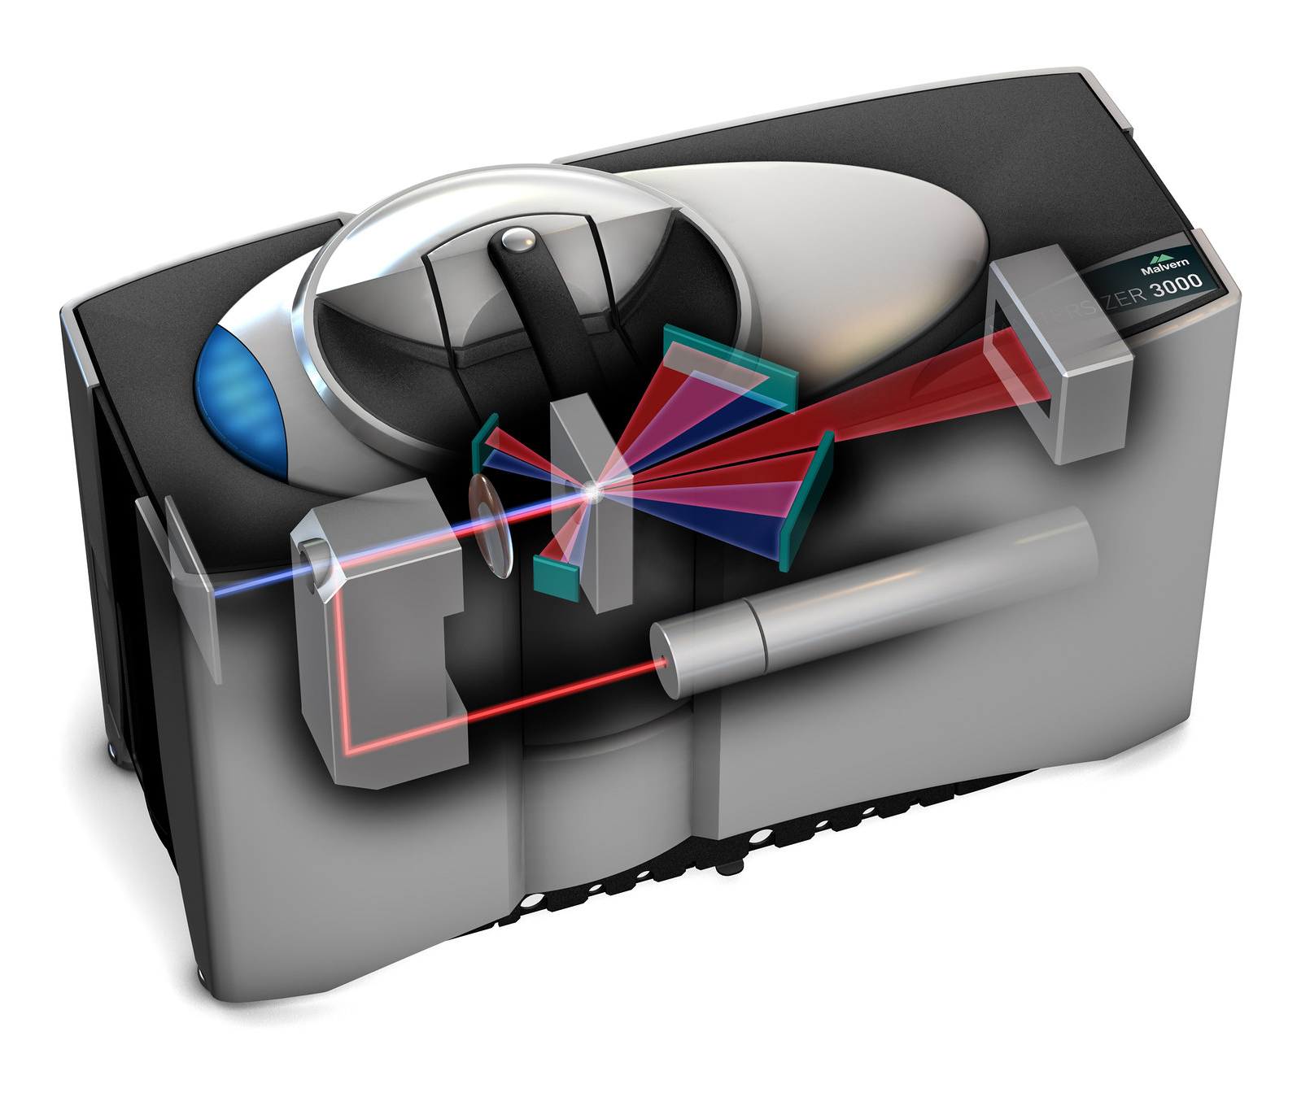
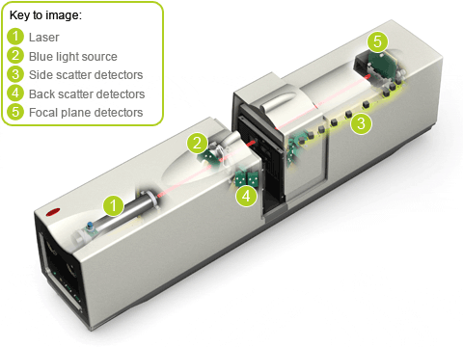
Instrument model and analysis range
Dynamic range
Mastersizer 2000 | Mastersizer 3000
0.02µm to 2000µm | 0.01µm to 3500µm

Slide 7
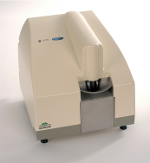
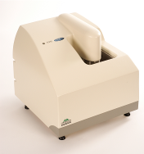
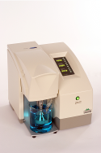
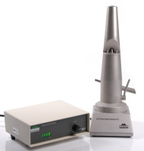
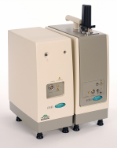
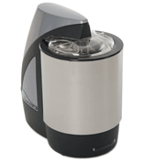
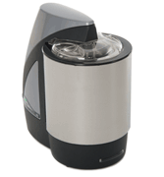
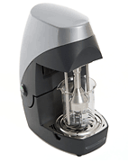
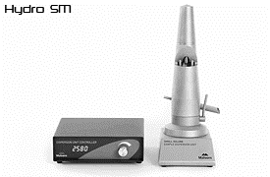
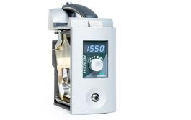
Instrument model and analysis range
Liquid dispersion units
Hydro 2000S | Hydro 2000G | Hydro 2000MU | Hydro 2000SM | Hydro 2000μP
120ml | 1000ml | 1000ml | 80-120ml | 18ml
Hydro MV | Hydro LV | Hydro EV | Hydro SM | Hydro SV
120ml | 600ml | 600ml/1000ml | 80-120ml | 6-7ml

Slide 8
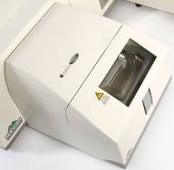
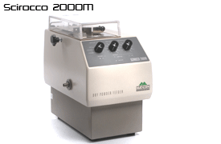
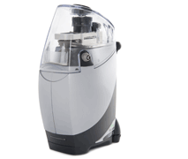
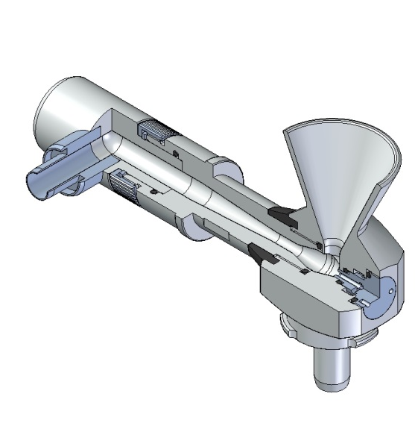
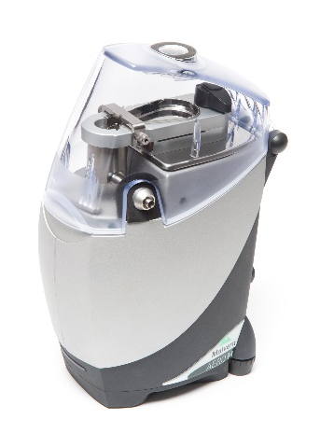
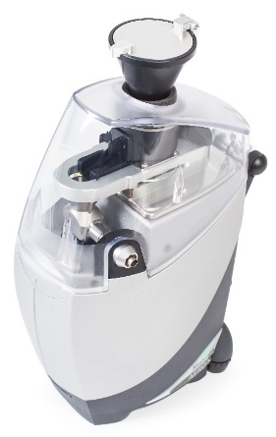
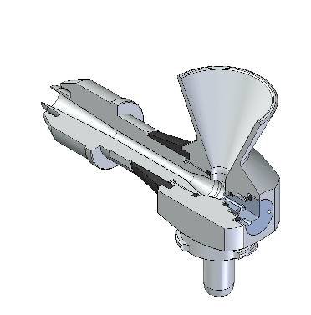
Instrument model and analysis range
Dry dispersion units
Scirocco |  |  | Scirocco M
Aero S |  |  | Aero M | Aero Funnel Sample Feeder
 | Standard | High energy

Slide 9
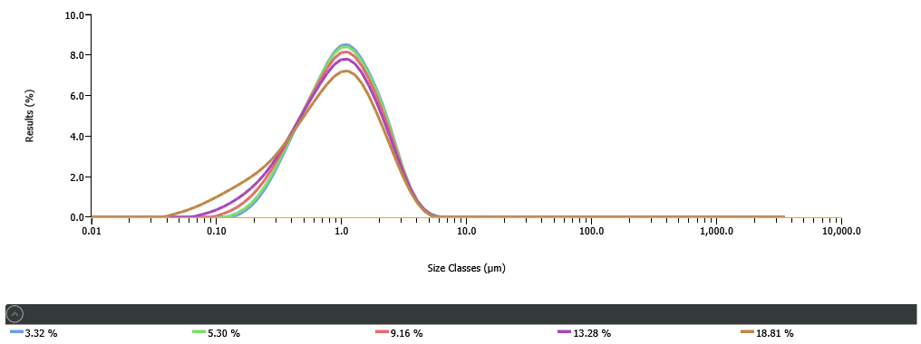
Laser obscuration
Changes in the optical design have reduced the susceptibility of the system to multiple scattering

Slide 10
Dispersion state Liquid

Slide 11
Achieving comparable wet dispersion
Ultrasound titration
In-line sonication can reduce required ultrasound duration
  Use an ultrasound titration to achieve the same state of dispersion

Slide 12
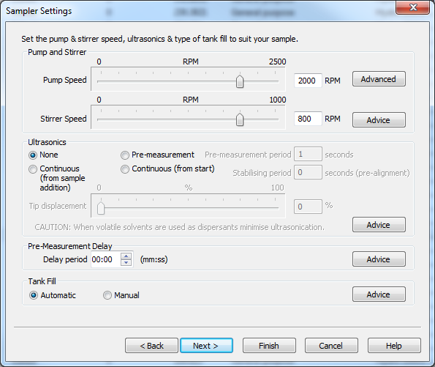
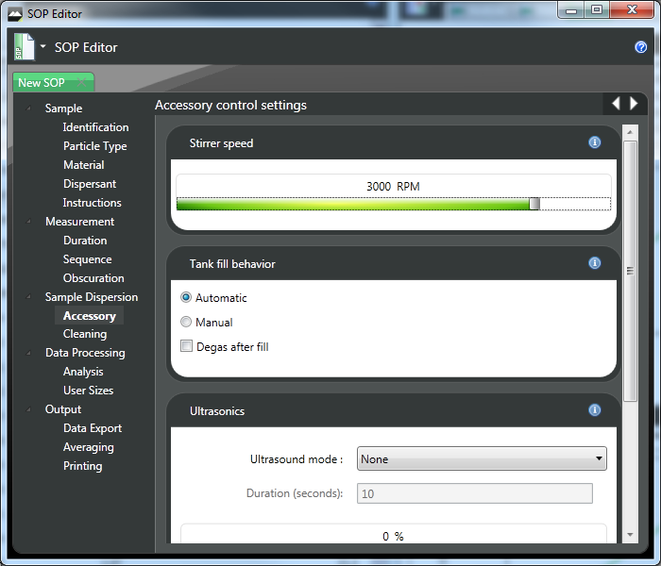
Differences in the sampler settings
Mastersizer 3000 dispersion units have a combined pump and stir

Slide 13
Stir speed titration
Confirm sample suspension with stirrer speed titration

Slide 14
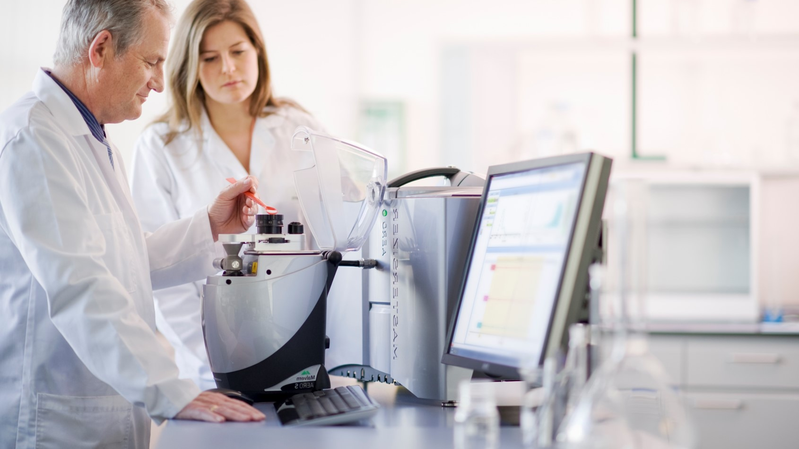
Dispersion state dry

Slide 15
Achieving comparable dry dispersion
Degree of dispersion is controlled by primary air pressure
  Monitor change in size distribution with pressure
    Carry out pressure titration

Slide 16
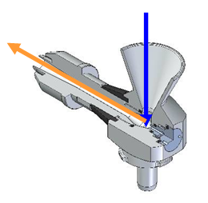
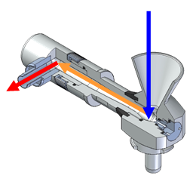
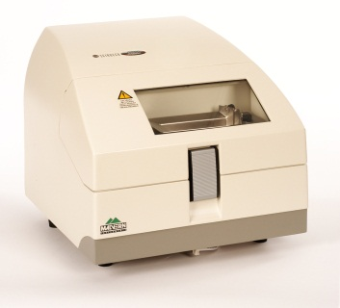
Comparing pressure titrations on Scirocco & Aero
Standard and high energy dispersers available
Comparable results may be at different pressures

Slide 17
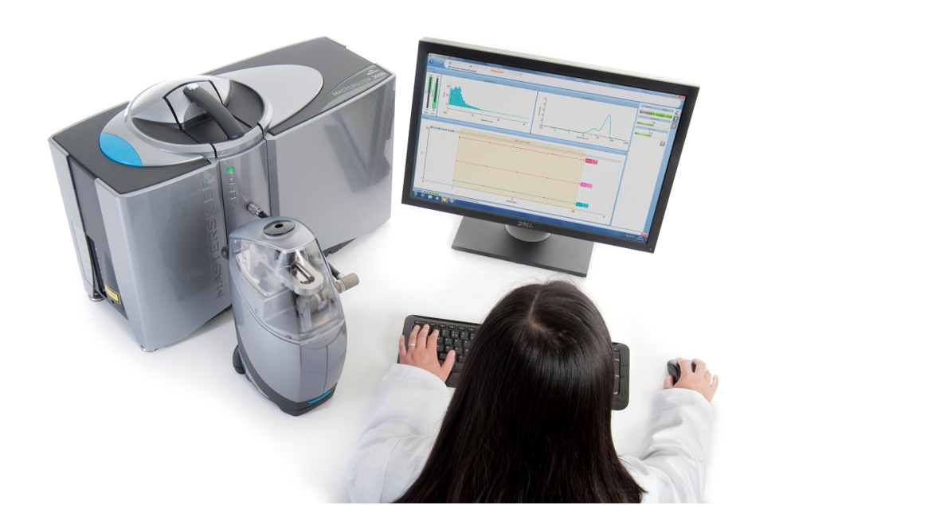
Examples

Slide 18
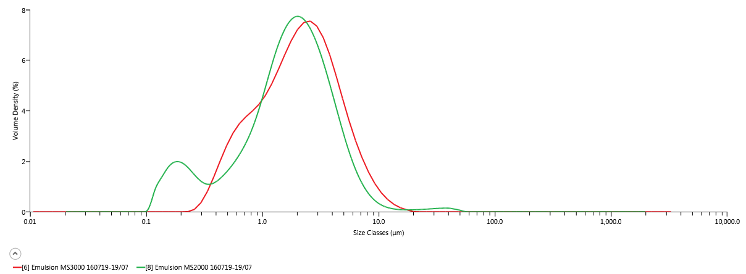
Emulsion data as supplied

Slide 19
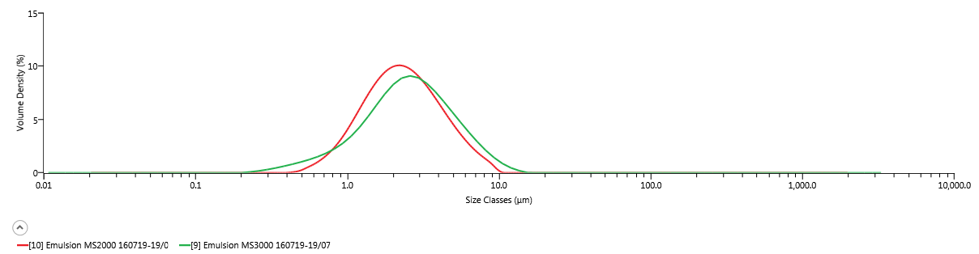
Some concerns
Older instrument seeing more fines and coarse than new one (which has more capability)
Optical properties used were 1.475, 0.01
For emulsions imaginary RI is normally in the order of magnitude of 0.001
Residual fell from 0.66% to 0.35%
Look at stir speed next

Slide 20
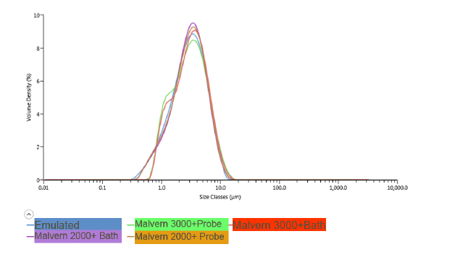
Pharmaceutical example -1
Imaginary RI of 0.1 used on MS2000, ideally want to keep same, sample preparation makes no difference. Could change RI, or use 2000 analysis
Latter preferred as minimal revalidation needed

Slide 21
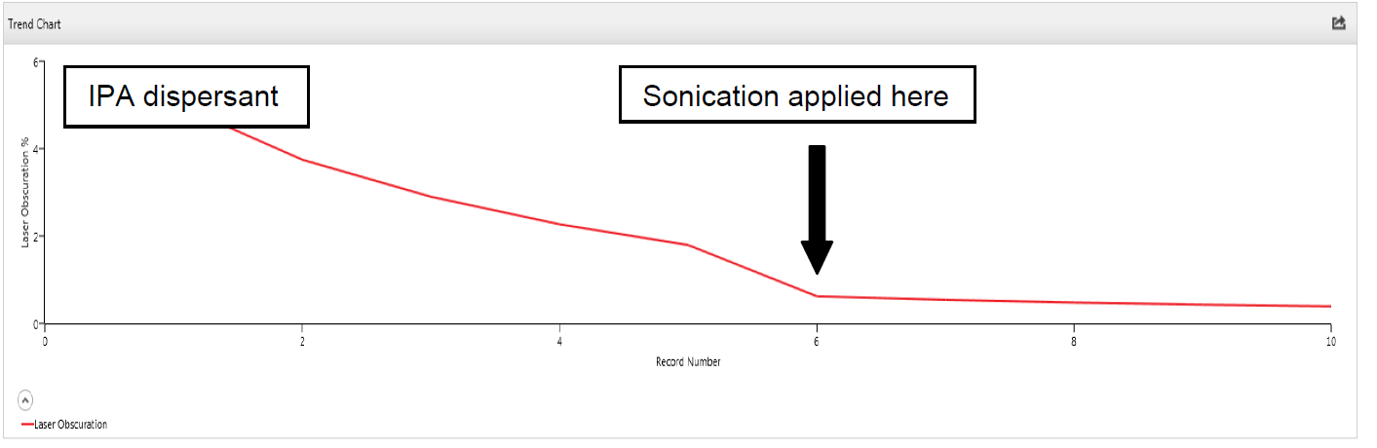
Pharmaceutical example - 2
Transfer is a good time to examine the old method
Old method. Single measurement. Due to changes in good measurement practice decided to take multiple measurements
High obscuration, short measurement masked dissolution!!

Slide 22
Pharmaceutical example - 2
What happened?
Switched to a new dispersant
Fortunately same specification was able to be used

Slide 23
Graphite
Anode material for batteries
Method examined to check dispersion
Slurry made up in water with a little Igepal
No ultrasound required

Slide 24
Graphite Method Transfer
Measurement settings | Mastersizer 2000 | Mastersizer 3000
Particle refractive index | 2.6 | 2.6
Particle absorption index | 1 | 1
Dispersant refractive index | 1.33 | 1.33
Particle type / Particle shape | Irregular | Non-spherical
Analysis model | General purpose | General purpose
Analysis sensitivity | Normal | Normal
Obscuration range | 5% -15% | 5% - 15%
Measurement duration (red) | 10s | 10s
Measurement duration (blue) | 10s | 5s
Accessory | Hydro MU | Hydro LV
Stir speed | 2500rpm | 2500rpm

Slide 25
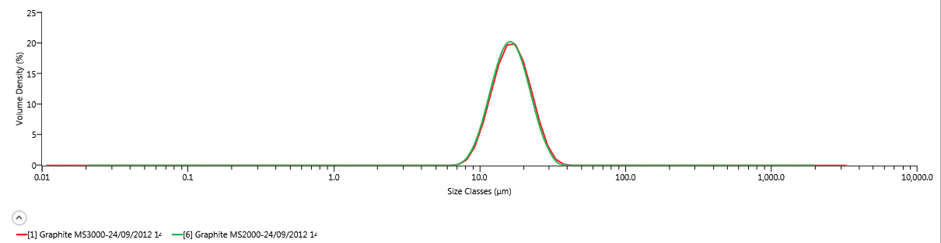
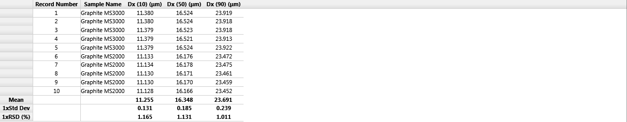
Graphite Final Results

Slide 26
Lithium Cobalt Oxide
Method examined to check dispersion
Slurry made up in water with a little Igepal
No ultrasound required

Slide 27
Lithium Cobalt Oxide Method Transfer
Measurement settings | Mastersizer 2000 | Mastersizer 3000
Particle refractive index | 1.74 | 1.74
Particle absorption index | 1 | 1
Dispersant refractive index | 1.33 | 1.33
Particle type / Particle shape | Irregular | Non-spherical
Analysis model | General purpose | General purpose
Analysis sensitivity | Normal | Normal
Low obscuration limit | 5% - 15% | 5% - 15%
Measurement duration (red) | 10s | 10s
Measurement duration (blue) | 10s | 5s
Accessory | Hydro MU | Hydro LV
Stir speed | 2500rpm | 2500rpm

Slide 28
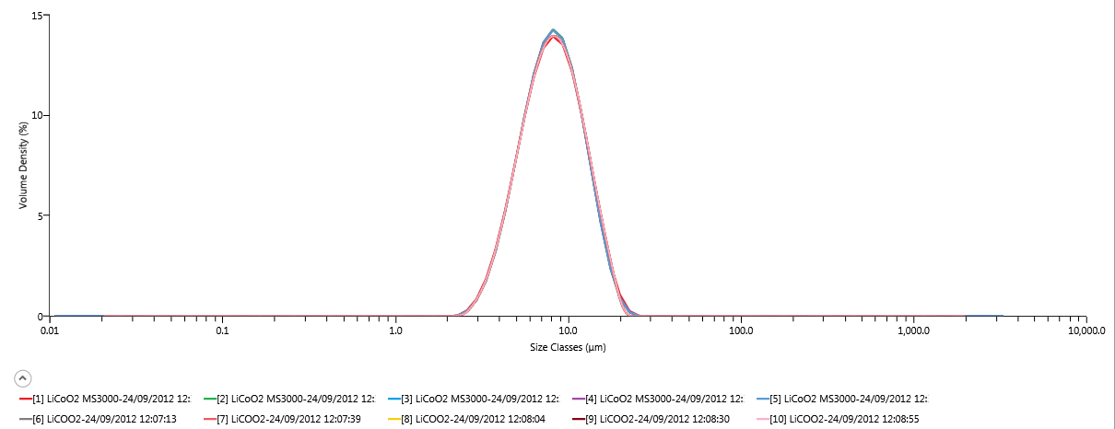
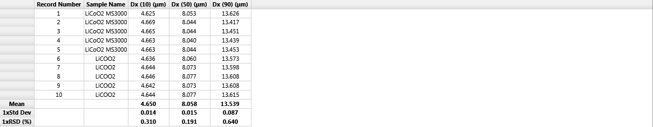
Lithium Cobalt Oxide final results

Slide 29
Tungsten Carbide
Here we do see the need to optimise dispersion with ultrasound. Need 3 minutes with an external probe to disperse the sample

Slide 30
Tungsten Carbide Method Transfer
Measurement settings | Mastersizer 2000 | Mastersizer 3000
Particle refractive index | 2.24 | 2.24
Particle absorption index | 2 | 2
Dispersant refractive index | 1.33 | 1.33
Particle type / Particle shape | Irregular | Non-spherical
Analysis model | General purpose | General purpose
Analysis sensitivity | Normal | Normal
Low obscuration limit | 5% - 10% | 5% - 10%
Measurement duration (red) | 10s | 10s
Measurement duration (blue) | 10s | 5s
Accessory | Hydro MU | Hydro LV
Stir speed | 2500rpm | 2500rpm

Slide 31
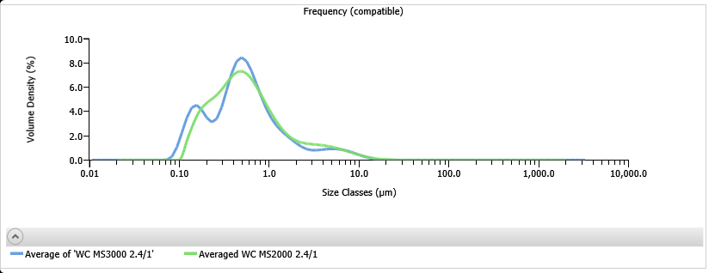
Initial optical model needed examination

Slide 32
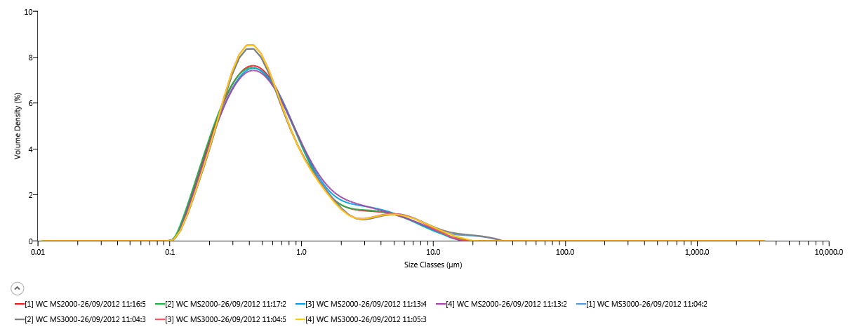
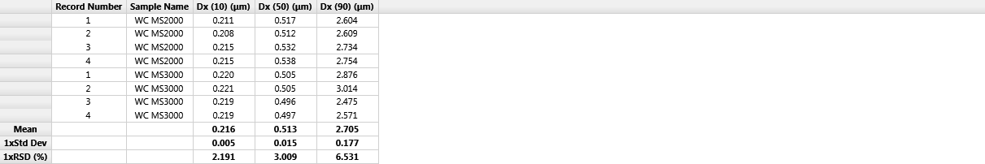
Tungsten Carbide final results

Slide 33
In conclusion
It is easy in most cases to transfer methods from Mastersizer 2000 to Mastersizer 3000
Changes to dispersion might be needed (different ultrasound power)
Mastersizer 2000 analysis available

Slide 34
Acknowlegements
Thank you to everyone who has given me permission to use data in this presentation

